Slide 1
PRESENTATION TEMPLATE – HOW TO USE THIS SLIDE IS TO BE DELETED ONCE YOUR PRESENTATION IS READY
This template is for your organization:
Add your organization’s logo
Remove anything you don’t want to include
Add or edit content so that it suits your needs
The notes at the bottom of the slide contain some key messages you could say, suggestions for some activities and ideas you can take or leave

Slide 2
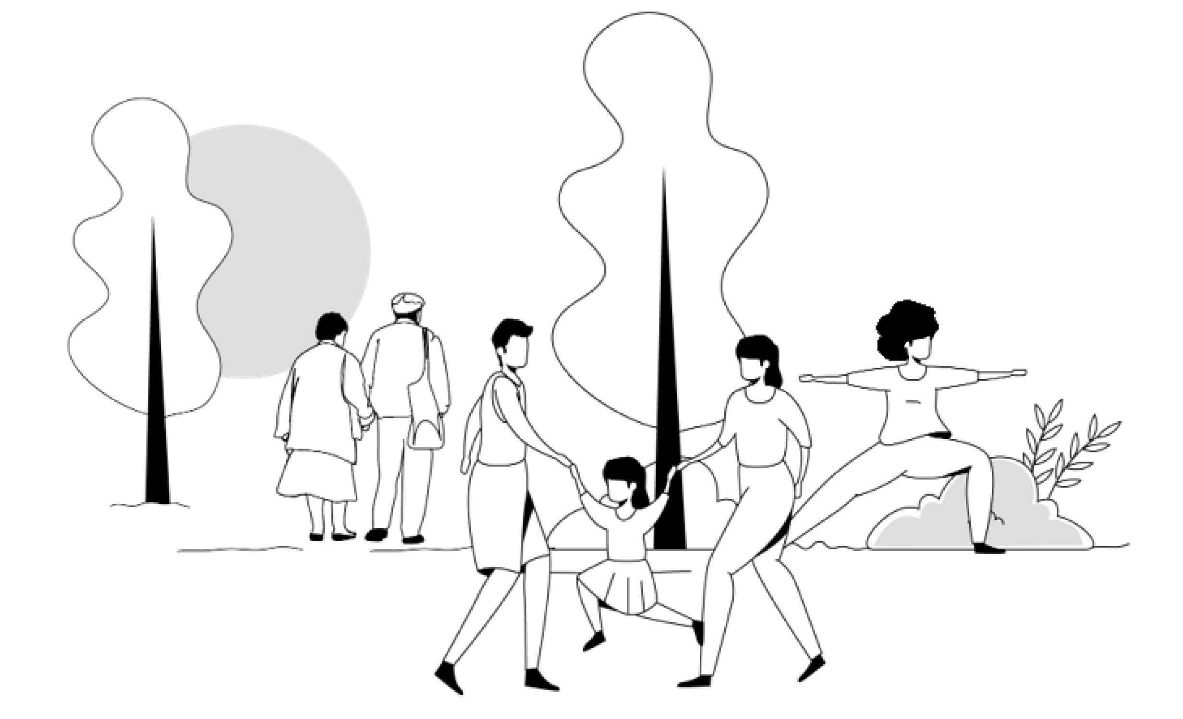
Social Prescribing at [name of your organisation]

Slide 3

WHAT IS SOCIAL PRESCRIBING?
An intentional, structured way of connecting people with a range of local, non-clinical services, to address the determinants of health and wellbeing for people accessing primary care.
Notes:
Key messages: Social prescribing can look different for each community depending on resources and supports.

Slide 4

WHAT IS SOCIAL PRESCRIBING?
But social prescribing isn’t new!
That’s true!
A new name for something we [may be/are] already doing
Building a more formal social prescribing pathways:
helps make it intentional
helps streamline the process of connecting clients to resources
documents the work
provides data for quality improvement
provides a strong case for increased funding and resources
Notes:
Delete if irrelevant to your situation

Slide 5

WHAT IS SOCIAL PRESCRIBING?
Instead of asking
We are asking
What is the matter with you?
What matters to you?

Slide 6
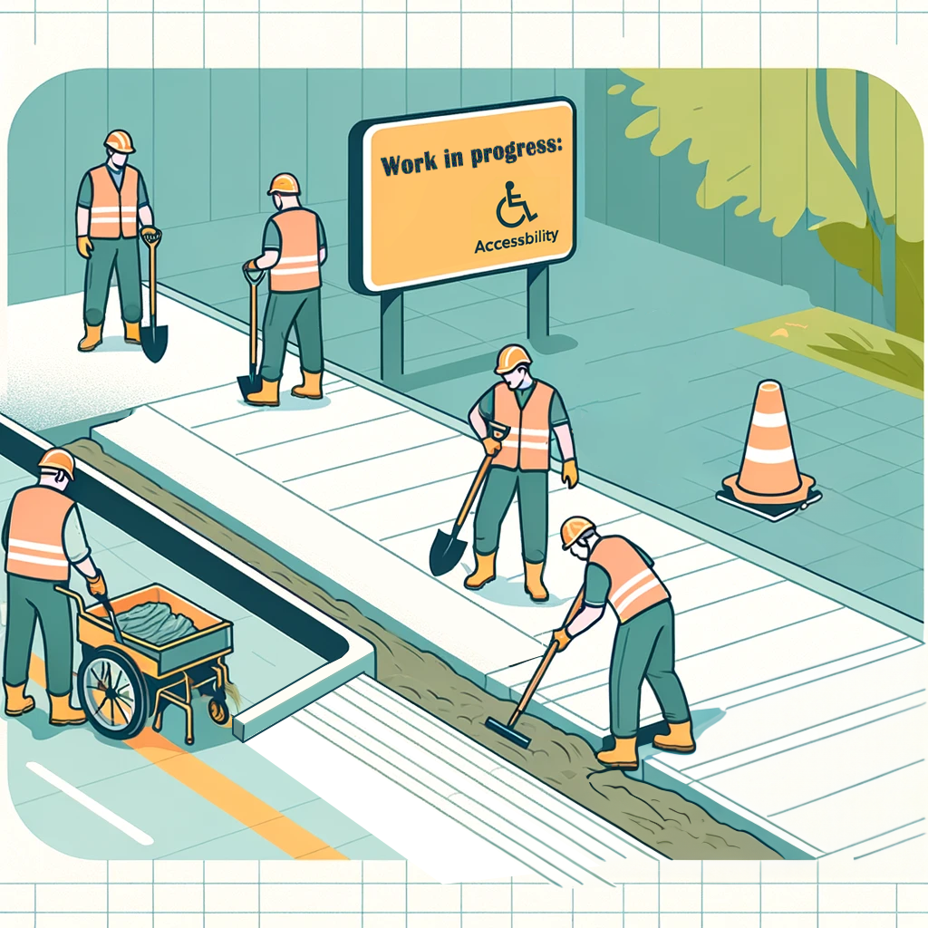
WHAT IS SOCIAL PRESCRIBING?
Health equity is a cornerstone of effective social prescribing.
Successfully implementing a social prescribing program means removing the barriers clients experience.

Slide 7


SOCIAL PRESCRIBING PATHWAY COMPONENTS
1/4
PROVIDER
CLIENT
(Physician, nurse, dietician…)
Needs other than clinical
Notes:
Suggested script: Typically, a SP pathway looks like this:
A client is identified as having needs other than clinical, during a clinical visit.

Slide 8

SOCIAL PRESCRIBING PATHWAY COMPONENTS
2/4
Referral
NAVIGATOR/CONNECT
OR
PROVIDER
CLIENT
Notes:
2. The provider refers the client to a navigator -- or connector -- via a formal referral.

Slide 9











SOCIAL PRESCRIBING PATHWAY COMPONENTS
3/4
Referral
NAVIGATOR/CONNECT
OR
PROVIDER
CLIENT
Notes:
3. The navigator then connects with the client.
Together, they identified the client’s interests, needs and barriers to participation.
The navigator then connects them with the appropriate community resources and programs.
The navigator follows up with the client.

Slide 10
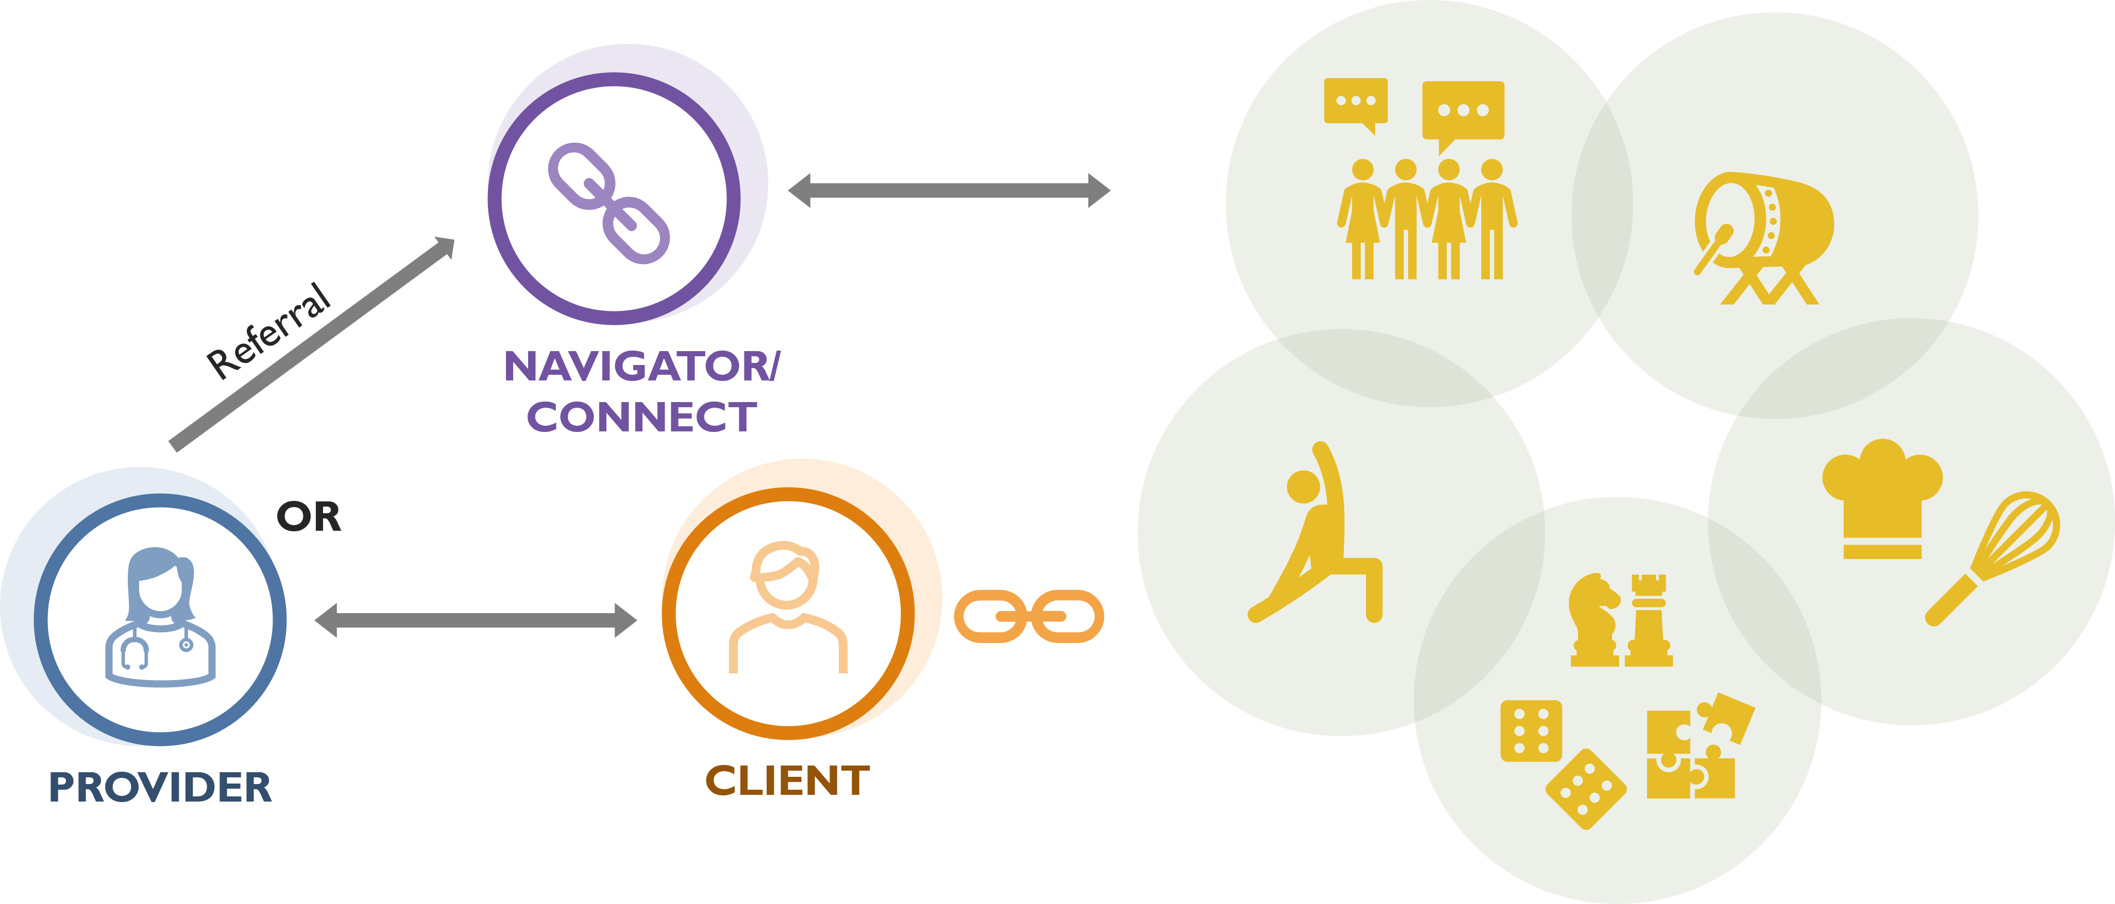

SOCIAL PRESCRIBING PATHWAY COMPONENTS
4/4
Tracking through a learning Health System:
Client journey
Follow up
Improvements
Document in EMR
Document in EMR
Document in EMR
Notes:
3. The navigator then connects with the client.
Together, they identified the client’s interests, needs and barriers to participation.
The navigator then connects them with the appropriate community resources and programs.
The navigator follows up with the client.

Slide 11







SP WORKS IN MANY SETTINGS
Lakeshore Community Nurse Practitioner Led Clinic, https://lcnplc.ca/ Located in a smalltown. Nurse Practioners are the lead providers of primary health care.
Centre de santé communautaire in Temiskaming https://www.csctim.on.ca/ (covers a huge rural area, no link worker).
Regent Park CHC https://regentparkchc.org/ (serve a urban population, low-barrier model of services including ground floor Consumption & Treatment Services & Harm Reduction space)
Somerset West CHC https://www.swchc.on.ca/ Black-focused social prescribing, urban setting, on-site community programs and many resources available.
Harrow Health Centre Family Health Team https://harrowfht.ca/ – Small, rural, farming community.
Mino M’shki-ki Indigenous Health Team https://minomshkiki.ca/ providing culturally meaningful services and programs
1
2
3
6
2
4
4
5
3
1
6
5
Notes:
Key message: Social prescribing can look different for each community depending on resources and supports. The type of centre can vary from a nurse practionner-led clinic (NPLC), to a family health team, a community health center, the size and composition of the team can look very different with a link worker (or navigator) or none, the location can be very rural or very urban, etc.

Slide 12



THE IMPACT OF SOCIAL PRESCRIBING
The impacts of social prescribing from programs in the UK (2017-2019) meant that from social prescribing, the healthcare system saw a:
14%
40%
20.8%
Decrease in emergency room visits
decrease in general
physician visits
(especially repeated visits)
Reduction in costs to the health care system

Slide 13


POSITIVE IMPACTS FOR CLIENTS AND PROVIDERS
The ability to offer social prescriptions has decreased my visits. It has alleviated stressors for my clients. I have seen positive turn-arounds in clients’ overall mood. Social prescribing also helps ease the strain on our health system, while giving clients a sense of community and belonging that COVID-19 restraints eroded.
— Terry, Health Provider
Winsor

Slide 14

POSITIVE IMPACTS FOR CLIENTS AND PROVIDERS
For 6 months I resisted asking the questions [about loneliness and wellbeing] to the client, thinking it would take too long. When I finally did it, it took no more than a minute!
— A nurse
A nurse

Slide 15

POSITIVE IMPACTS FOR CLIENTS AND PROVIDERS
I appreciated the kindness of people and realizing that there are nice people in this world. It’s just a matter of finding them. Another lady I know, she’s in her eighties, and she lost her husband about a year ago. She is very lonely. That’s why I encouraged her to go to Life After Fifty. Like me, she needed the initial push to go, but I think once she goes, she’ll enjoy it.
— Linda, Links2Wellbeing Project Participant
Seaway Valley CHC

Slide 16
PROMPTS FOR REFLECTION
“What are some non-clinical programs and services in our community that could support our clients?”
“How could social prescribing advance equity work at our centre?”

Slide 17
FAQs
I don't like that it's called a "prescription."
For some communities the term social prescribing doesn't quite fit and that’s OK! You might like the language of social connection better. Some Indigenous sites use "restoring medicine wheel balance."
You can use language that fits you and your community.
Notes:
Key messages: Social prescribing can look different for each community depending on resources and supports.

Slide 18
FAQs
I don't like that it's called a "prescription."
For some communities the term social prescribing doesn't quite fit and that’s OK! You might like the language of social connection better. Some Indigenous sites use "restoring medicine wheel balance."
You can use language that fits you and your community.
Notes:
The following slides are answers to commonly asked questions. Use them if needed

Slide 19
FAQs
It will work in other centres but not in ours.
Social prescribing looks different at every organization. There are Community Health Centres, Nurse Practitioner Led Clinics, Family Health Teams, and Hospitals that all implement social prescribing.
It works in all kinds of communities and all kinds of organizations.

Slide 20
FAQs
“You need to have a link worker, and we don't have one”.
Many organizations have built social prescribing pathways that don't include a linkworker:
Some providers (clinicians) directly make the referral using the EMR
Some providers refer the client to an inter-professional team that meets weekly (called “bridges”)
Notes:
Add link to conference
+ video from Seaway Valley

Slide 21
Next steps: [Add next steps for your team following the onboarding meeting]

